Slide 1
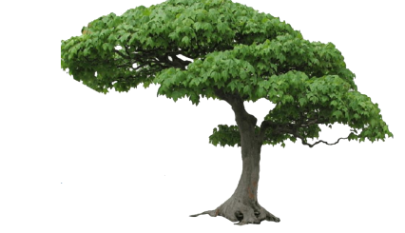
Decision tree

Slide 2
Definition
A schematic, tree-shaped diagram used to determine a course of action or show a statistical probability.
Each branch of the decision tree represents a possible decision, occurrence or reaction.
The tree is structured to show how and why one choice may lead to the next, with the use of the branches indicating each option is mutually exclusive.

Slide 3

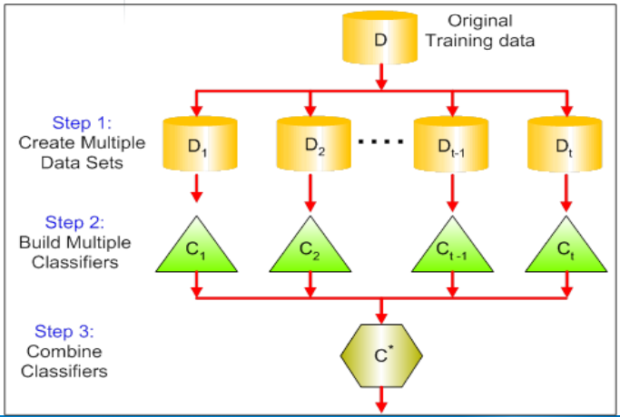
Decision tree vs Random forest
“Random forests are a combination of tree predictors such that each tree depends on the values of a random vector sampled independently and with the same distribution for all trees in the forest.”

Slide 4
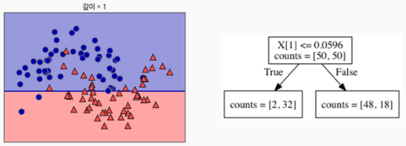
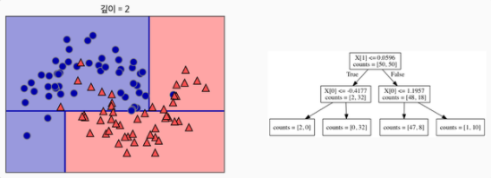
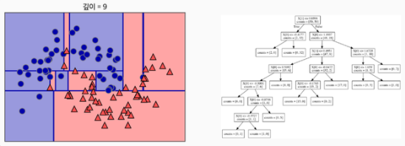
Decision tree process
먼저 위와 같이 데이터를 가장 잘 구분할 수 있는 질문을 기준으로 나눕니다.
나뉜 각 범주에서 또 다시 데이터를 가장 잘 구분할 수 있는 질문을 기준으로 나눕니다.
지나치게 데이터를 많이 나누면 위 그림과 같이 데이터의 분할이 필요이상으로 진행된 것을 알 수 있습니다. 이를 Overfitting이라고 합니다. (Overfitting을 막기 위한 방법은 Pruning이 있습니다. )

Slide 5
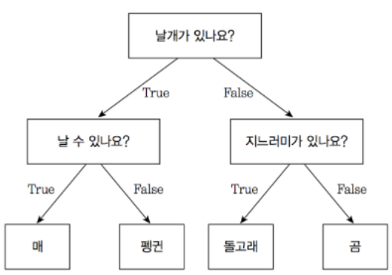
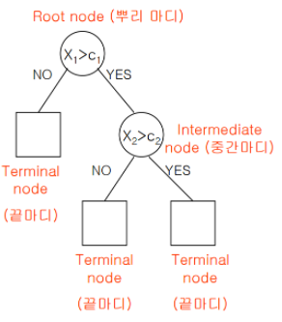
WHAT IS nODE?
Node: 질문이나 정답을 담은 네모 상자
Root Node : 맨 처음 분류 기준 (첫 질문)
Leaf Node(Terminal Node) : 맨 마지막 노드

Slide 6

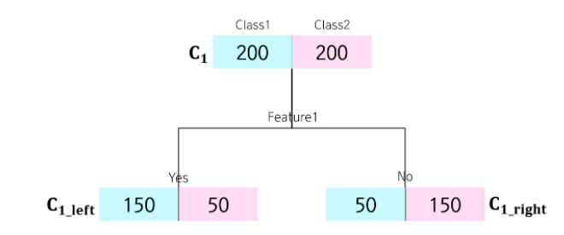
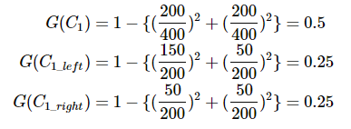
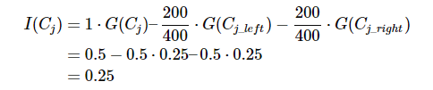


Feature importance
Gini importance
Information gain
Feature importance

Slide 7
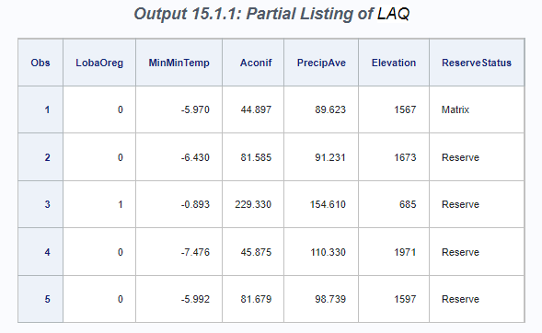
Table of data set
See first five observations
proc print data=sampsio.LAQ(obs=5);
var LobaOreg MinMinTemp Aconif PrecipAve Elevation ReserveStatus; run;
The LAQ data set consists of 30 measurements of environmental conditions, such as temperature, elevation, and moisture, at 840 sites.
These variables are treated as predictors for the response variable LobaOreg (our main object), which is coded as 1 if the lichen species Lobaria oregana was present at the site and 0 otherwise.

Slide 8
HPSPLIT procedure to create a classification tree for LobaOreg
GROW statement specifies the entropy criterion for splitting the observations during the process of recursive partitioning that results in a large initial tree
PRUNE statement requests cost-complexity pruning to select a smaller subtree that avoids overfitting the data.
Partition fraction statement decided to divide data into trainset and test set.
‘VALIDATE =0.3’ means that train set is 70% and test set is 30%
Seed is a parameter for random selection.
In the case of binary outcomes, the EVENT= option is used to explicitly control the level of the response variable that represents the event of interest for computing the area under the curve (AUC), sensitivity, specificity, and values of the receiver operating characteristic (ROC) curves.
Note: These fit statistics do not apply to categorical response variables that have more than two levels, so the EVENT= option does not apply in that situation. Likewise, this option does not apply to continuous response variables.
ods graphics on;
proc hpsplit data=sampsio.LAQ;
class LobaOreg ReserveStatus;
model LobaOreg (event='1') =
Aconif DegreeDays TransAspect Slope Elevation PctBroadLeafCov
PctConifCov PctVegCov TreeBiomass EvapoTransAve EvapoTransDiff
MoistIndexAve MoistIndexDiff PrecipAve PrecipDiff RelHumidAve
RelHumidDiff PotGlobRadAve PotGlobRadDiff AveTempAve AveTempDiff
DayTempAve DayTempDiff MinMinTemp MaxMaxTemp AmbVapPressAve
AmbVapPressDiff SatVapPressAve SatVapPressDiff ReserveStatus;
grow entropy;
partition fraction(VALIDATE = 0.3, SEED =123)
prune costcomplexity;
output out = scored;
run;

Slide 9
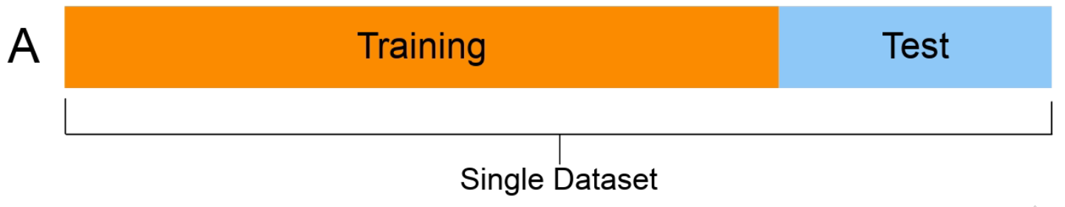
partition fraction(VALIDATE = 0.3, SEED =123) 추가설명
Train data set( 훈련/학습 데이터 셋)
모델을 학습시킬 때 사용할 데이터 셋
Validation data set (검증 데이터 셋)
Train set으로 학습한 모델의 성능을 측정하기 위한 데이터 셋
SEED
임의의 데이터 선정을 위한 파라미터이다.
같은 번호를 입력하면 같은 결과가 나오지만 다른 번호를 입력하면 데이터 셋이 달라졌기 때문에 다른 결과가 나온다.

Slide 10
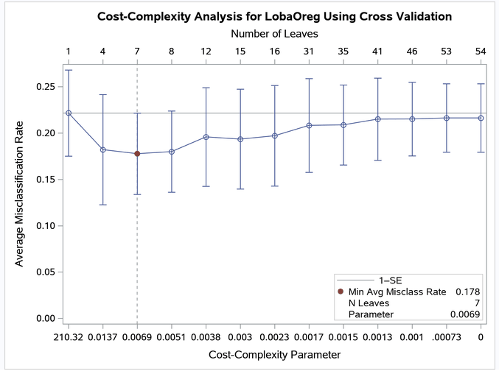

Misclassification Rate (error rate) as a Function of Cost-Complexity Parameter
Definition
전체 값에서 오차의 값이 발생한 비율
모형이 제대로 예측하지 못한 관측치를 평가하는 지표
Misclassification rate는 전체 관측치 중 실제 값과 예측 치가 다른 정도를 나타내며 1-accuracy 또는 다음과 같은 식으로 나타낸다.
Selects the smallest subtree for which the misclassification rate is less than the minimum rate plus one standard error. >> Minimum error rate is at 7 leaves, so select subtree with six leaves.

Slide 11
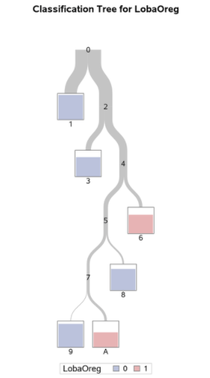
Overview of Fitted Tree
The color of the bar in each leaf node indicates the most frequent level of LobaOreg and represents the classification level assigned to all observations in that node.
The height of the bar indicates the proportion of observations (sites) in the node that have the most frequent level.
Note: there is impurity in each leaf node. In other words, there can be LobaOreg observation values 1 and 0 in each node.

Slide 12
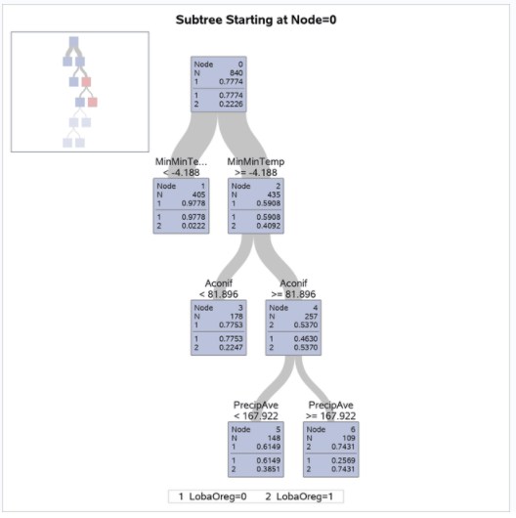
First Four Levels of Fitted Tree
The diagram provides more detail about the nodes and splits in the first four levels of the tree. It reveals a model that is highly interpretable.
The 435 sites for which MinMinTemp –4.188 (node 2) are further subdivided based on the variable Aconif, which is the average age of the dominant conifer at the site. Lobaria oregana is present at 53.7% of the 257 sites for which MinMinTemp –4.188 and Aconif 81.896 years.

Slide 13
The 257 sites for which Aconif 81.896 are further subdivided on the basis of PrecipAve (average monthly precipitation) with a cutoff value 167.922 mm.
Lobaria oregana was present at 74.31% of the 109 sites for which MinMinTemp –4.188, Aconif 81.896 years, and PrecipAve 167.922 mm.
Contrast this occupancy percentage with the 2.22% for the sites for which MinMinTemp –4.188.
In summary, based on the first three splits, Lobaria oregana is most likely to be found at sites for which MinMinTemp –4.188, Aconif 81.896, and PrecipAve 167.922.

Slide 14
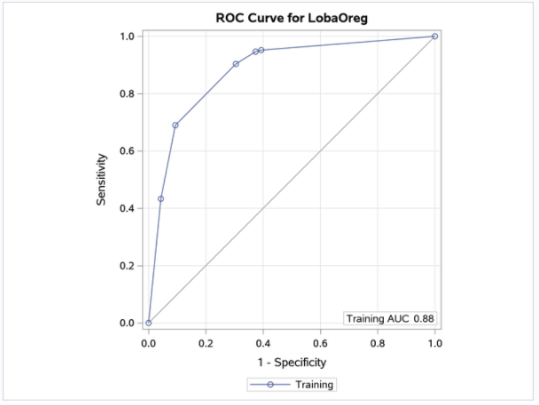
ROC Curve for Classification
The AUC statistic and the values of the ROC curve are computed from the training data. When you specify a validation data set by using the PARTITION statement, the plot displays an additional ROC curve and AUC statistic, whose values are computed from the validation data.
Note: In this example, the computations of the sensitivity, specificity, AUC, and values of the ROC curve depend on defining LobaOreg=1 as the event of interest by using the EVENT= option in the MODEL statement.
진단의 관점에서 민감도(sensitivity)는 질병이 있는 사람을 얼마나 잘 찾아 내는가에 대한 값이고 특이도(specificity)는 정상을 얼마나 잘 찾아 내는가에 대한 값이다.

Slide 15
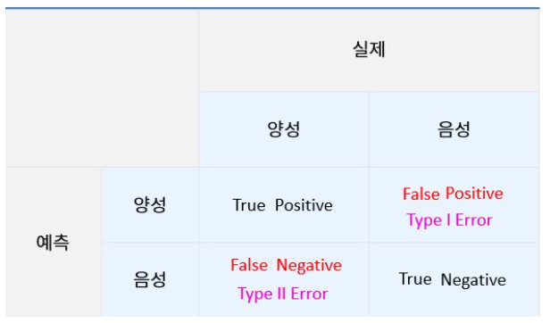
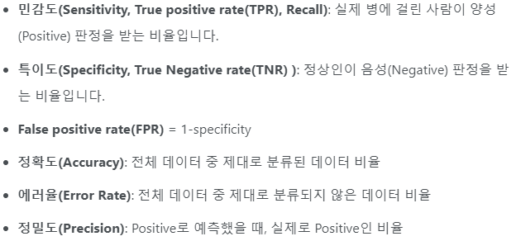
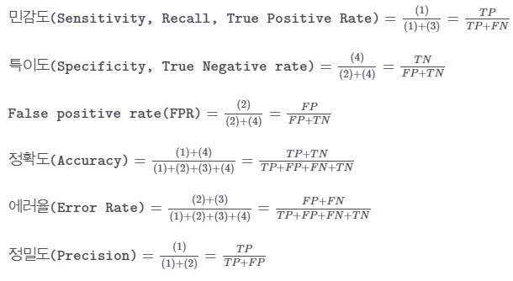
Roc curve

Slide 16
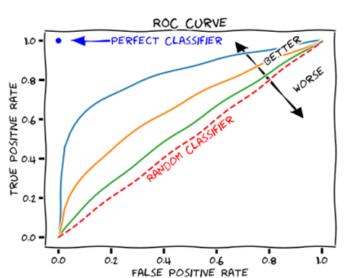
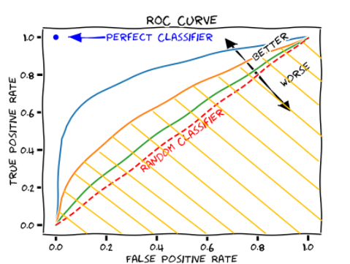
ROC curve interpretation
The colored area is AUC (정확성 지표)

Slide 17
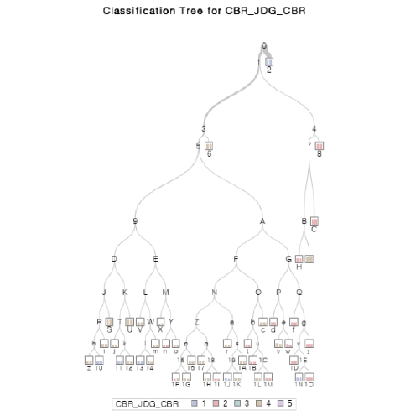
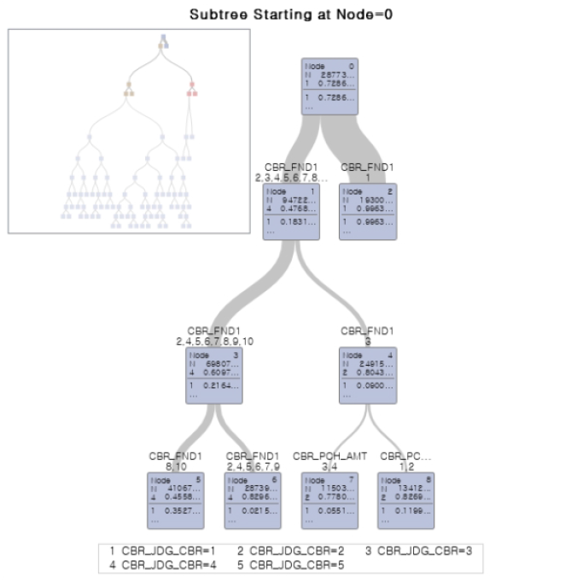
Result: CBR_JDG_CBR

Slide 18
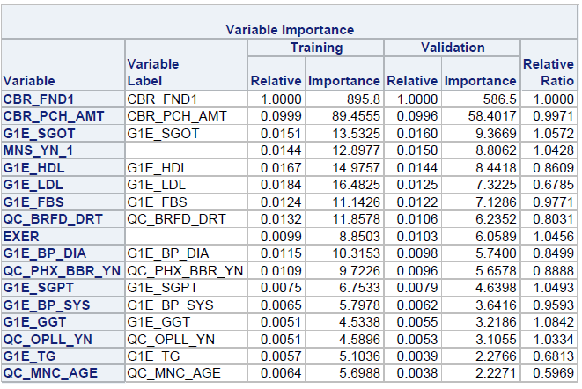
VARIABLE IMPORTANCE

Slide 19
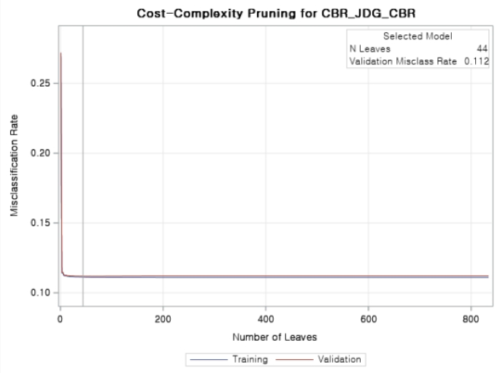
Result: misclassification rate

Slide 20
Reference
https://documentation.sas.com/doc/ko/pgmsascdc/9.4_3.4/stathpug/stathpug_hpsplit_examples01.htm
https://m.blog.naver.com/sharp_kiss/221826800044
https://codedragon.tistory.com/9618
https://www.sas.com/content/dam/SAS/en_ca/User%20Group%20Presentations/Toronto-Data-Mining-Forum/dzieciolowski-randomforests.pdf
https://towardsdatascience.com/how-to-find-decision-tree-depth-via-cross-validation-2bf143f0f3d6

